Slide 1

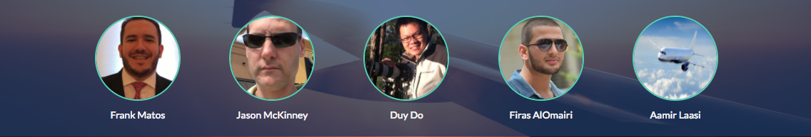
Mavericks Flight Tracking Mobile App

Slide 2
Meet our team
Aamir – SCRUM & Project Manager
Duy – Front End
Frank – Front End
Firas – Back End
Jason – Back End
Notes:
Frank - Introduction

Slide 3
Objectives
Problem we are solving
Proposed Solution
Front End (UI/UX)
Technologies
Back End (APIs)
DEMO
Q&A
Notes:
Frank - Agenda

Slide 4
PROBLEM
Notes:
Frank - Problem
Nowadays, flying is the preferred method of transportation for long distances. For example; George Bush International served 44 million passengers in 2015. Airports are always packed and getting to your gate on time sometime can be a challenge.
Here is Houston for example, we need to account for traffic, which can easily make you late for your flight. Sometimes you need park miles away, check in, go through TSA, walk some more to get to your gate. Let’s not forget the lines and you’re luck if you find a seat to wait for boarding. We need to be diligent to make sure to be at the gate on time.

Slide 5
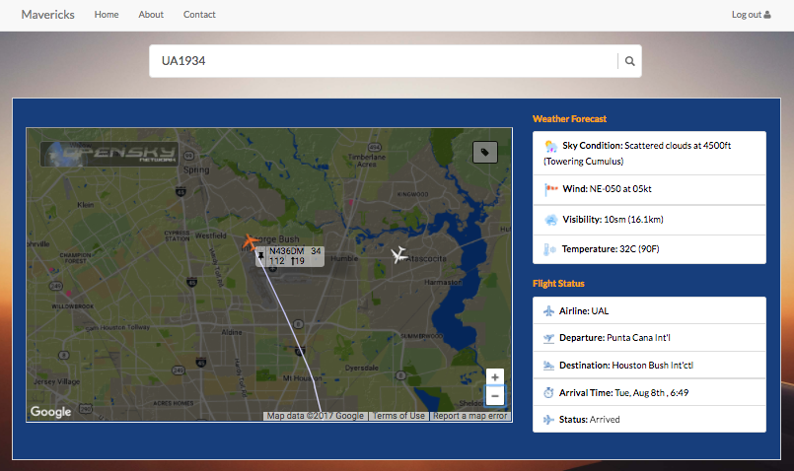
SOLUTION
Notes:
Frank & Duy – Solution (Front End)
Our idea was to develop an application where travelers could check their flight status of their flight, but wanted to go a step further, our goal was also to provide weather information and a map so travelers could see where their airplane was live. The weather information we would display would be the same whether information pilots, airport and airline employees have access so the traveler would have access to the same information. And the map, that is the cool factor.
We wanted the app to friendly to aviation enthusiasts and the weather information and the live map give those users a whole different meaning. They can see the information about the flight, altitude, heading, the weather information can give them clues to which runway they use, whether or not a flight would be affected by adverse weather, and so on.
You can type in a city an airport name and you will see weather information and the live map showing all flight on that specific area. You can click on the airplane and see additional information about the flight (altitude, heading, etc) and it’s route. On the top right hand corner, you’ll see weather information, sky condition, wind direction, visibility and temperature. ON the lower right hand corner, you’ll see flight information, departure, arrival, status, etc.
Tracking your loved ones
Checking Weather – Origin and Destination

Slide 6
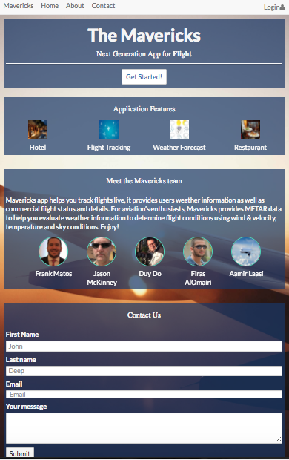
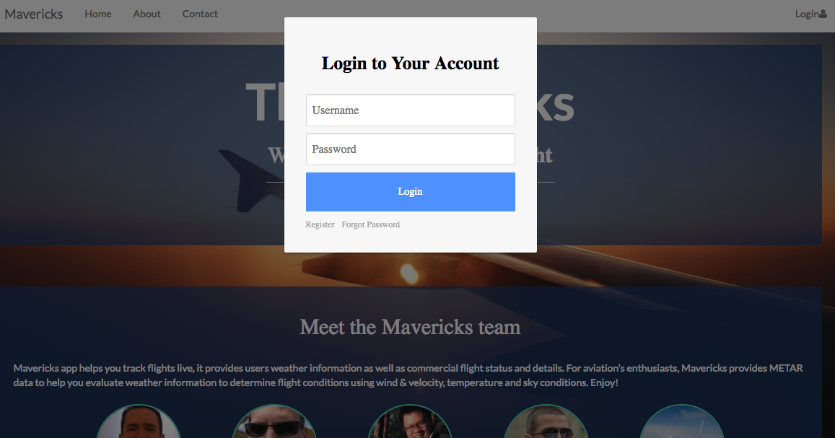
Front End

Slide 7
Technologies Used
Wireframe.cc – App Layout
ICAO – Airport Info
FlightAware – Flight Status
AVWX – Weather
OpenSky – Map
Jquery Widget Autocomplete
AVWX
Notes:
Aamir – Technologies (Back end explanation)
*Make sure to mention the 2 new technologies, Wireframe and Jquery Autocomplete.

Slide 8
DEMO
Notes:
Jason & Faris

Slide 9
Q&A

